Slide 1
COBOL FILE HANDLING
  Data Organization, access and processing

Slide 2
OBJECTIVES
Introduction to Files, Records & Fields
SELECT and ASSIGN clause in COBOL
COBOL file operations
  OPEN
  READ
  WRITE
  CLOSE
File Organization & Access
Single & Multiple Record Layout

Slide 3
Files, Records & Fields
COBOL is generally used in situations where volume of data to be processed is large
Large volumes of data arises not only because data is inherently voluminous but also same items of information have been recorded about great many instances of same object
We use the term field to describe an item of information, record to describe collection of fields and file to describe a collection of one or more occurrences (instances) of a record type (template)
It is important to differentiate between record type (structure of record) and record occurrence (value of a record). Every record in the file has a different value but the same structure

Slide 4
Files, Records, Fields
RECORD TYPE(STRUCTURE ):
01 EMPLOYEE-RECORD.
05 EMPLOYEE-NAME PIC X(30).
05 EMPLOYEE-NO PIC 9(6).
RECORD OCCURRENCE:
BILL GATES 100001
STEVE JOBS 100002
DAVID PETERS 100003
File will be collection of 3 records of record type EMPLOYEE-
RECORD having fields EMPLOYEE-NAME, EMPLOYEE-NO

Slide 5
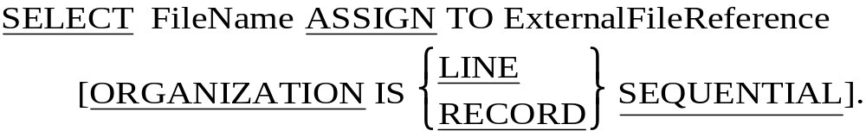
SELECT & ASSIGN Syntax
Internal File Name (Logical File) used in the FD entry (DATA DIVISION) is connected to external file (Physical File) on disk or tape using SELECT-ASSIGN clause.
This SELECT-ASSIGN Clause is part of the ENVIRONMENT DIVISION's INPUT-OUTPUT SECTION's FILE-CONTROL paragraph.
LINE SEQUENTIAL means each record is followed by carriage return and line feed characters
RECORD SEQUENTIAL means file consists of stream of bytes. Only the fact that we know the size of each record allows us to retrieve them

Slide 6
FD Entry
Under FILE SECTION of the DATA DIVISION, the FD Entry defines the layout of the File SELECTed in the ENVIRONMENT DIVISION.
FD Entry Syntax:
  FD InternalFileName
    LABEL RECORDS ARE [STANDARD/OMITTED]
    RECORD CONTAINS <Recnum> CHARACTERS
    BLOCK CONTAINS <Blkrec> RECORDS.
  01 <Recordname> PIC X(Recnum).
COPY Statement can also be used to define the layout here.

Slide 7
COBOL file handling verbs
OPEN – Before program can access the data from input file or place data in an output file, file must be made available to the program by OPENing it
READ – READ copies the record occurrence from a file and copies it into the record buffer
WRITE – WRITE copies the record from record buffer into the file
CLOSE – Program must CLOSE the files it has opened. Failure to do so may result in data not being written to file or users being prevented from accessing the file

Slide 8

OPEN, CLOSE, READ & WRITE SYNTAX
OPEN, CLOSE, READ & WRITE SYNTAX
  INPUT – File is opened only for Input, the file must exist and be accessible, the only permissible operation is WRITE
  OUTPUT – File is opened only for Output, the only operation permitted is WRITE. If the File exists old data gets replaced, if new the file is created and the data is written into it
  I-O – File is opened both for WRITE and READ, the file must exist and be accessible
  EXTEND – File is opened only for output but in the Append mode, i.e records get added at the end of the File, the file must exist and be accessible

Slide 9
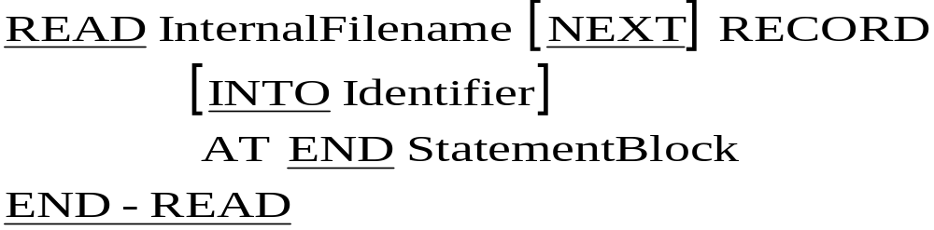
OPEN, CLOSE, READ & WRITE SYNTAX
  NEXT RECORD clause is optional for sequential files and is generally not used
  AT END is used to specify the operations to be carried out after the End of File is reached
  Using INTO identifier clause cause the data to be into record buffer and from there copied into specified identifier in one operation. It is equivalent to READ followed by MOVE

Slide 10
OPEN, CLOSE, READ & WRITE SYNTAX
Example of a READ Statement
Here PERFORM UNTIL is used to continuously read the file until EOF condition is reached
PERFORM UNTIL END-OF-FILE
READ EMP-FILE INTO EMP-REC
AT END MOVE ‘Y’ TO FILE-END-INDICATOR
END-READ
END-PERFORM.

Slide 11
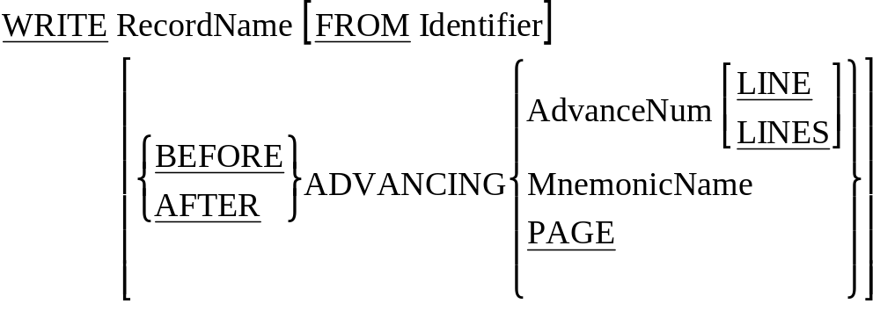
OPEN, CLOSE, READ & WRITE SYNTAX
To WRITE data to a file, move the data to the record buffer (declared in FD entry) and then write the contents of record buffer to the file
If the Record data is in a Working Storage Variable, then FROM is used to indicate that Identifier from which the Record should be written

Slide 12
ORGANISATION & ACCESS
Two important characteristic of files are
  DATA ORGANISATION
  METHOD OF ACCESS
Data Organisation refers to the way the records are organized on the storage device. COBOL recognizes three main organizations:
  Sequential : Records organized serially
  Relative : Relative Record number based organization
  Indexed : Index based organization
The method of access refers to the way the records are accessed
  Relative or Indexed Organisation file may have its records accessed sequentially
  But Records in a file with organization of sequential can not be accessed randomly

Slide 13
SINGLE/MULTIPLE RECORD TYPE FILES
In a file which contains only one record type the record structure is described as part of the file FD using an 01 level number
Many a times, single file will contain more than one type of record.
  Assume Transaction file is applying transaction records to Employee file and it contains one record type for each transaction. i.e. Insertion, Deletion and Update
  These kinds of transactions in real life are collected into one single transaction file which will contain different record types ( records with different structures)
To describe these different record types, we have to use more than one record description in the file’s FD
Since Record description always start at 01 level, we will have multiple 01 level for each record type in the file

Slide 14
SAMPLE MULTIPLE RECORD LAYOUT
  DATA DIVISION.
  FILE SECTION.
  FD TRANS-FILE.
  01 INSERT-REC.
  02 TRANS-CODE PIC X.
  02 EMP-NUMBER PIC 9(6).
  02 EMP-NAME PIC X(35).
  02 EMP-JOIN-DT PIC X(10).
  02 EMP-GENDER PIC X.
  02 EMP-JOB-CODE PIC X(4).
  02 EMP-PAY PIC 9(6).

Slide 15
SAMPLE MULTIPLE RECORD LAYOUT
  01 DELETE-REC.
  02 TRANS-CODE PIC X.
  02 EMP-NUMBER PIC 9(6).
  01 UPDATE-REC.
  02 TRANS-CODE PIC X.
  02 EMP-NUMBER PIC 9(6).
  02 EMP-JOB-CODE PIC X(4).
  02 EMP-PAY PIC 9(6).

